Slide 1
Business Terms
LINE FILL RATE(LIFR)
VOLUME FILL RATE(VOFR)
ONTIME(OT)
INFULL(IF)
ONTIMEINFULL(OTIF)

Slide 2
Business Overview
Customer are not renewing their annual contracts
Suspected Reasons
Late Delivery
Unable to fullfill the demands of the customers

Slide 3

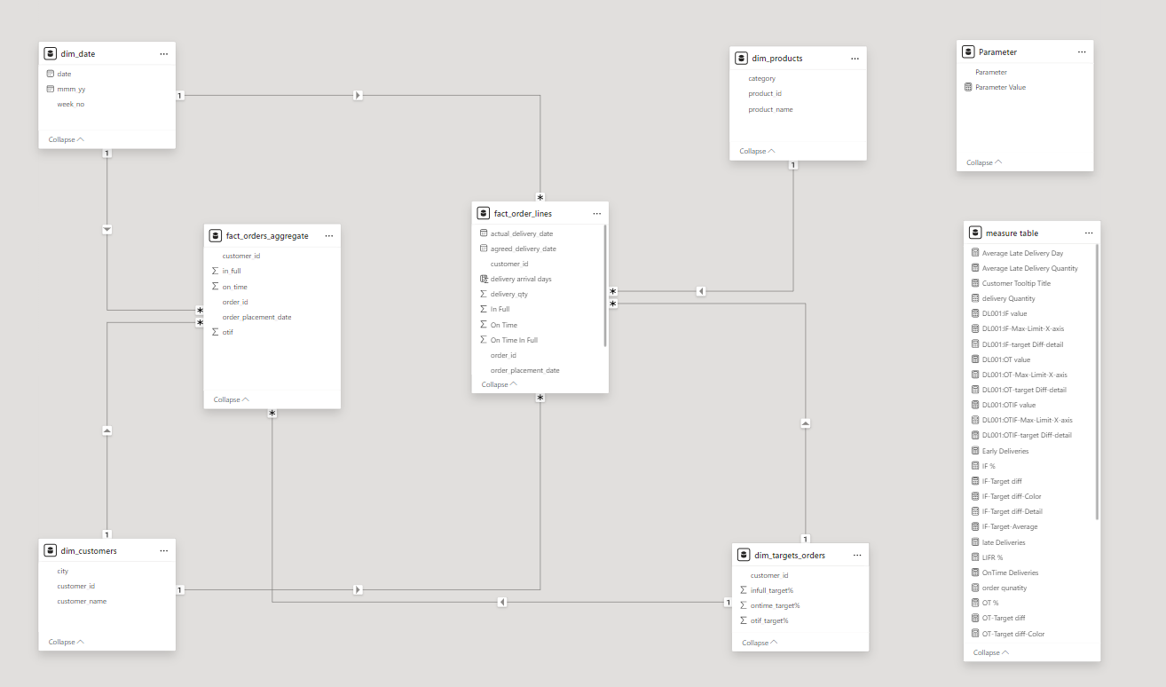



DATA MODELLING

Slide 4
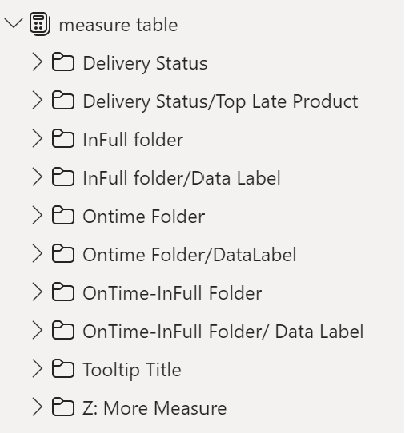
DAX Measure’s Folders

Slide 5

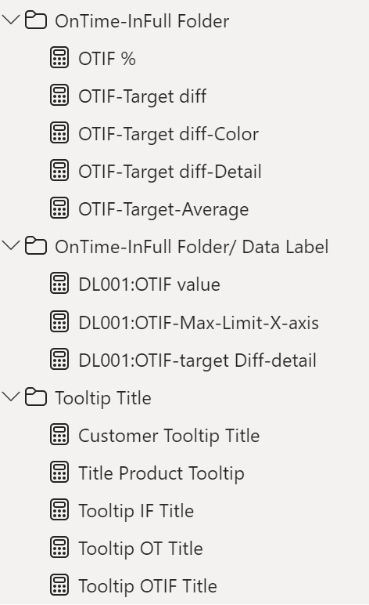
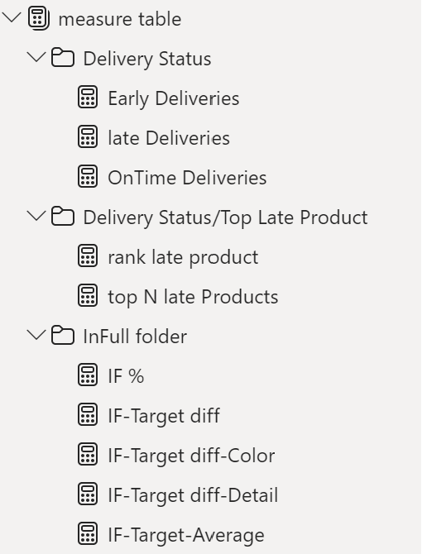
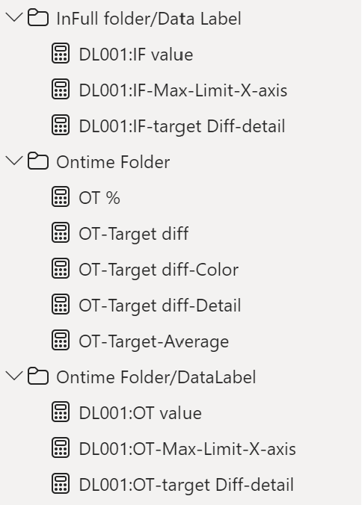
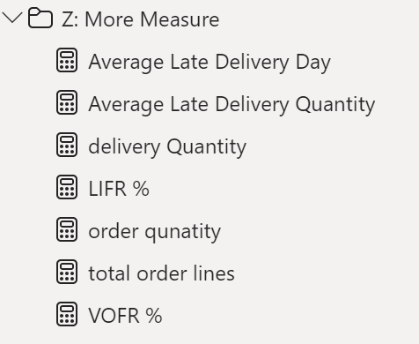
Dax Measures Within The Folders

Slide 6
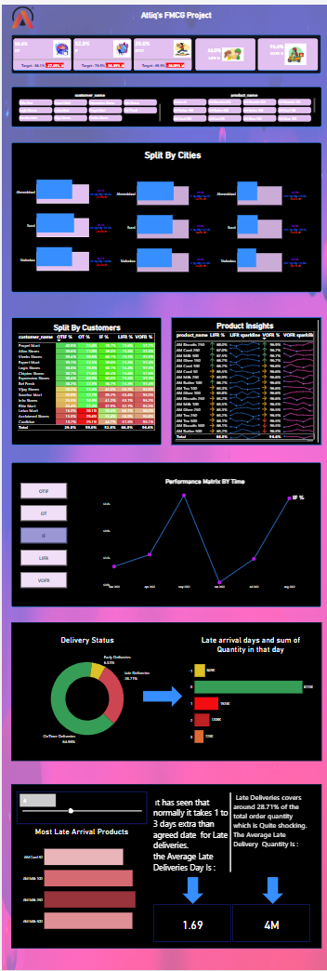
Dashboard In Fit To Page View

Slide 7
Major Insights
All the Key Metrics (OT%, IF%, OTIF%) are far behind the target
On an average, orders are delayed 0.42 days from the agreed date of delivery
Lotus Mart, Coolblue, Acclaimed stores have the highest orders as well as delayed the most to deliver the products on time
Ghee, curd and butter products are most delayed to deliver.
There is no noticeable improvements in any of the key metrics in the last few months

Slide 8
Thank you
Live as if you were to die tomorrow. Learn as if you were to live forever.

